Slide 1

Twitter Sentiment Analysis in AWS and Google Cloud
Team Name: Stratosphere
Inchara Raj
Nitya Navali
Priyanka Satish
Suraj Bagaria

Slide 2

What is Sentiment Analysis?
Sentiment analysis measures the inclination of people’s opinions through NLP.
The analyzed data quantifies the general public's sentiments or reactions toward certain products, people or ideas and reveal the contextual polarity of the information.
Notes:
Sentimental analysis is the study of people’s opinion, emotion, sentiments expressed in text in social media. We analysed the comments, determined the sentiment behind the statements and classified them as positive to negative sentiments. This helps business and analytics field in determining public feeling or opinion about their product and come up with better strategies to improve them.

Slide 3

Why do we need it?
To Adjust Marketing Strategy
Develop Product Quality
Improve Customer Service
Crisis Management

Slide 4

Purpose and Goals
A comparative study of sentiment analysis services provided by Google Cloud and Amazon AWS. With focus on performance, accuracy and features provided.
Build a Twitter Sentiment analysis application using AWS and google cloud services to evaluate the sentiments of tweets for a specific entity.

Slide 5
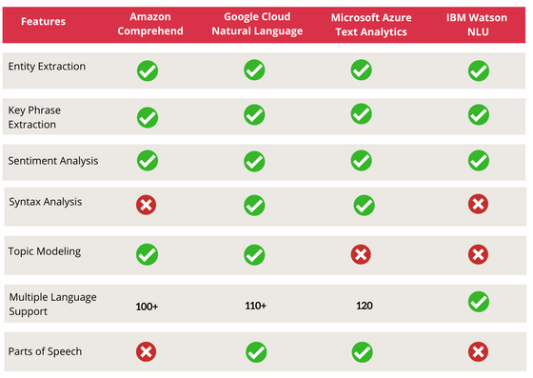
Features Comparison of NLP Services
Notes:
Line by line & doc
Langa

Slide 6
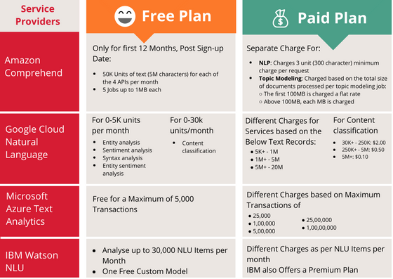
Cost Analysis

Slide 7
Testing Dataset to measure Accuracy
Twitter US Airline Sentiment dataset by Kaggle
Analyze how travelers in February 2015 expressed their feelings on Twitter.
Highly unstructured data - The grammar, spelling and diction are highly colloquial in tweets and therefore difficult to analyze.
Sent the text to be analyzed to Google and AWS APIs and received back the results
Notes:
There are plenty of sentiment analysis training data sets available for free. “Training” means that each chunk of text has been pre-categorised and verified by a human. We’re testing accuracy for pre-existing models.

Slide 8
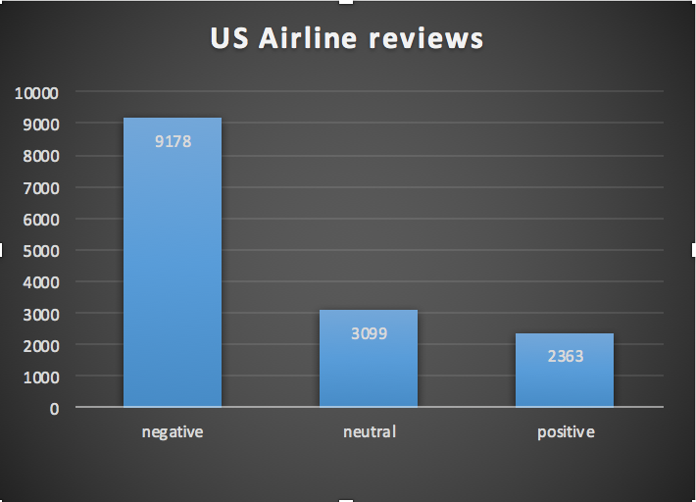
Category | Count
Positive | 2,363
Neutral | 3,099
Negative | 9,178
Total Tweets | 14,640

Slide 9
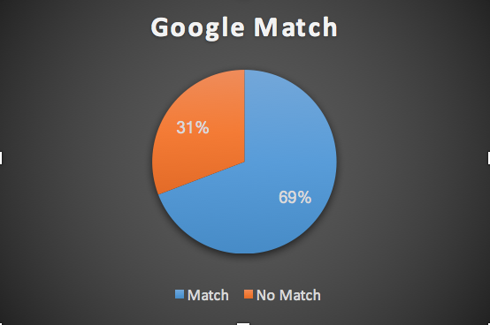
Google NLP
Google NLP | Count
Match | 10131
Mismatch | 4509
Grand Total | 14640

Slide 10
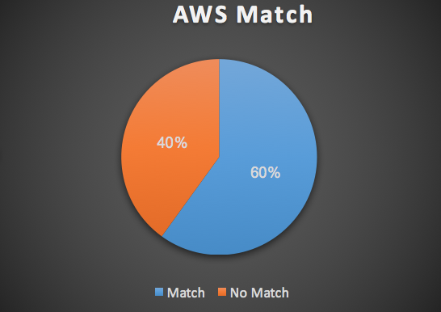
Amazon Comprehend
AWS Comprehend | Count
Match | 8,781
Mismatch | 5,859
Grand Total | 14,640

Slide 11
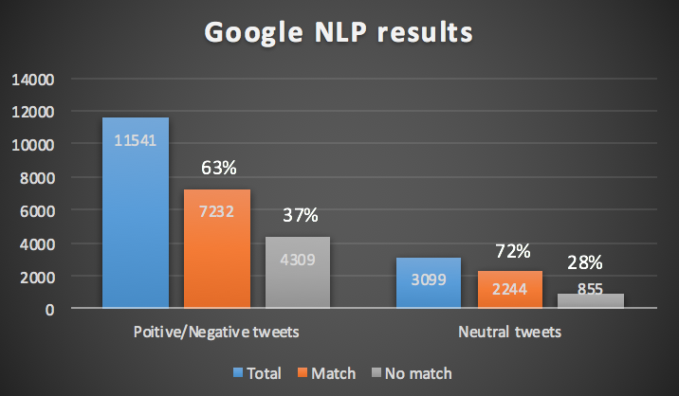
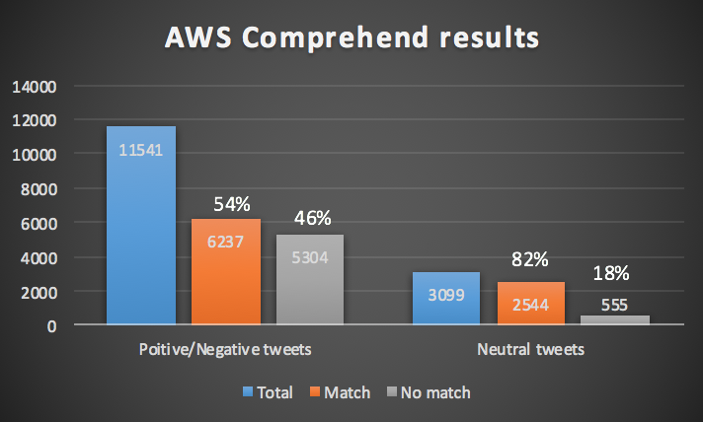

Slide 12

Google NLP seems to be more accurate.
But let’s try with a more structured dataset...

Slide 13
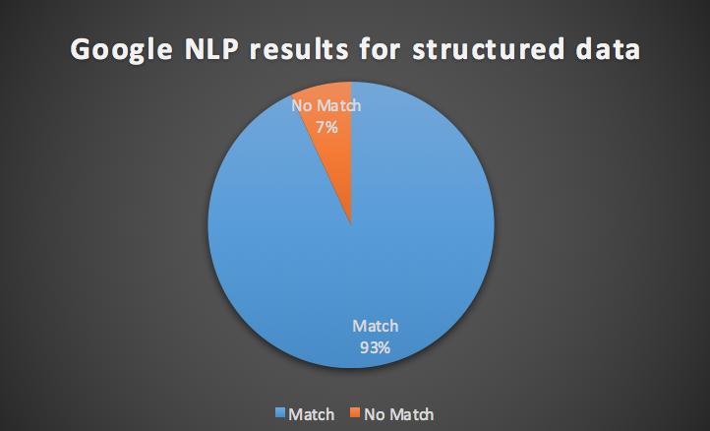
Yelp Dataset
Category | Google | Overall Match
Match | 931 | 93%
No Match | 69 | 7%
Grand Total | 1000
Notes:
Structured dataset with 500 Clearly positive and 500 clearly negative statements

Slide 14
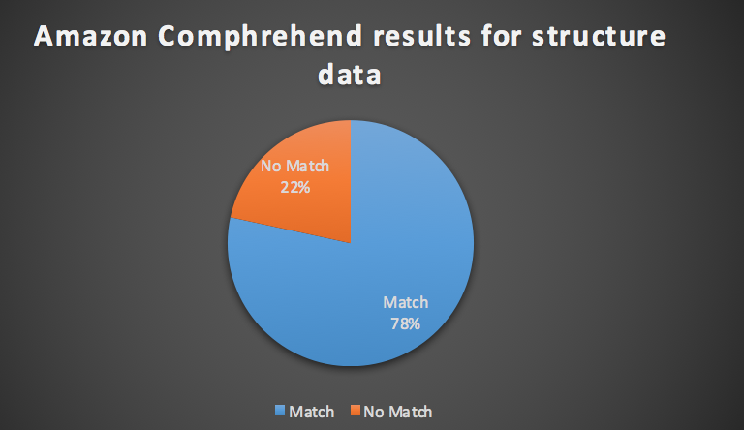
Column1 | AWS | Overall Match
Match | 784 | 78%
No Match | 216 | 22%
Grand Total | 1000

Slide 15
Tweets | Sentiment | Google Sentiment | AWS sentiment
I was shocked because no signs indicate cash only. | NEGATIVE | ✅ | NEUTRAL❌
At least think to refill my water before I struggle to wave you over for 10 minutes. | NEGATIVE | ✅ | NEUTRAL❌
This place is a jewel in Las Vegas, and exactly what I've been hoping to find in nearly ten years living here. | POSITIVE | ✅ | NEUTRAL❌
We were promptly greeted and seated. | POSITIVE | ✅ | NEUTRAL ❌

Slide 16
Google NLP is better in terms of accuracy in case of structured data too…..
How well can it understand sarcastic statements?

Slide 17
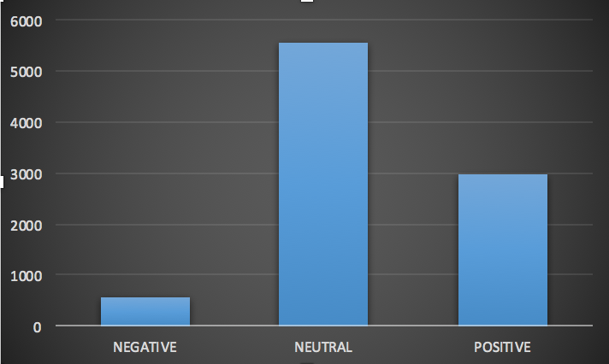
Apple Product/Service tweets

Slide 18
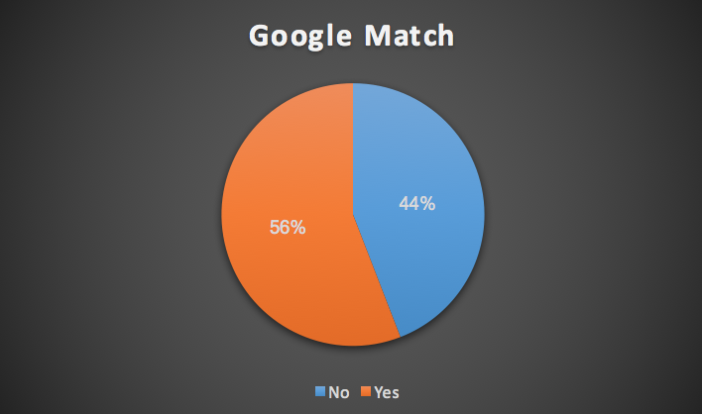
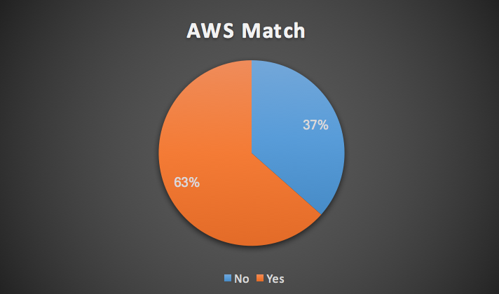
Results of Product/Service tweets

Slide 19
Where did google fail in this case?
Sarcastic Tweets | Sentiment | Google Sentiment | AWS sentiment
@sxsw I hope this year's festival isn't as crazy as this year's iPhone app. #sxsw | NEGATIVE | NEUTRAL❌ | ✅
Attending @mention iPad design headaches #sxsw | NEGATIVE | NEUTRAL❌ | ✅
The iPhone app is mocking me. Like I have the money to be there - COME ON. | NEGATIVE | NEUTRAL❌ | ✅
It's not all Apple love here at #sxsw. Heard quite a bit of grumbling about holding back features on iPad 1 so people would have to buy v2. | NEGATIVE | NEUTRAL ❌ | ✅

Slide 20

Performance
 |  |  |  |  |  |  | AWS Comprehend
 |  | Start time | End time | Total |  | Start time | End time | Total
American |  | 15:58:19 | 15:58:59 | 40sec |  | 13:44:25 | 13:44:59 | 34sec
Delta |  | 15:37:35 | 15:38:15 | 40sec |  | 14:02:59 | 14:03:33 | 34sec
Southwest |  | 15:44:33 | 15:45:15 | 42sec |  | 14:05:24 | 14:05:59 | 35sec
United |  | 18:04:49 | 18:05:34 | 45sec |  | 14:07:24 | 14:08:01 | 37sec
US Airways |  | 15:59:35 | 16:00:25 | 50sec |  | 14:09:26 | 14:10:00 | 34sec
Virgin America |  | 18:03:55 | 18:04:33 | 38sec |  | 13:41:49 | 13:42:22 | 33sec

Slide 21
Who is the winner?
Each service may perform better or worse depending on different types of text
Highly polar in nature
Less polar or Neutral & sarcastic statements - AWS
Faster execution & Performance - AWS

Slide 22
Technical Challenges faced
Google
Limit number of requests per 100 seconds to 1000. Not ideal when number of API requests are high as it leads to time out error.

Slide 23
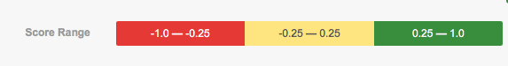
Interpreting Google sentiment scores
Google cloud lets you define and adjust a threshold after testing and verifying the results.
For example, you could at first define a threshold of any score over 0.25 as clearly positive and then after reviewing and testing the results, you could find that scores from 0.15-0.25 should be considered positive as well.
This could lead to inconsistencies.
Problem arises when there’s no benchmark to compare.

Slide 24
SAAS model for Twitter Sentiment Analysis on AWS
The system will be set up to evaluate the tweets made with a specific keyword in real time to provide insights on the sentiments and visualize them in the form of graphs.
DATA COLLECTION AND CLEANING
DATA INGESTION AND STREAMING
Data Analysation,Storage and Visualization
Tweets with specific hashtag will be extracted using Twitter standard search API and preprocessed to clean the data by removing unwanted information like url and mentions
Data collected is ingested in delivery stream which is responsible for sequential processing record-by-record basis or over sliding time windows.
Sentiment analysis is performed on every tweet and results are stored to perform visualization
1
2
3

Slide 25

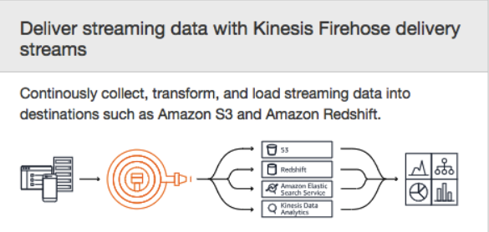
Kinesis Firehose :
Amazon Kinesis Data Firehose is a fully managed service for delivering real-time streaming data to destinations such as Amazon Simple Storage Service (Amazon S3), Amazon Redshift, Amazon Elasticsearch Service (Amazon ES), and Splunk.
You configure your data producers to send data to Kinesis Data Firehose, and it automatically delivers the data to the destination that you specified.
Notes:
a.Amazon Kinesis Data Firehose is a fully managed service for delivering real-time streaming data to destinations such as Amazon Simple Storage Service (Amazon S3), Amazon Redshift, Amazon Elasticsearch Service (Amazon ES), and Splunk.
b.You configure your data producers to send data to Kinesis Data Firehose, and it automatically delivers the data to the destination that you specified.
c.It automatically scales to match the throughput of your data and requires no ongoing administration. It can also batch, compress, transform, and encrypt the data before loading it, minimizing the amount of storage used at the destination and increasing security.

Slide 26

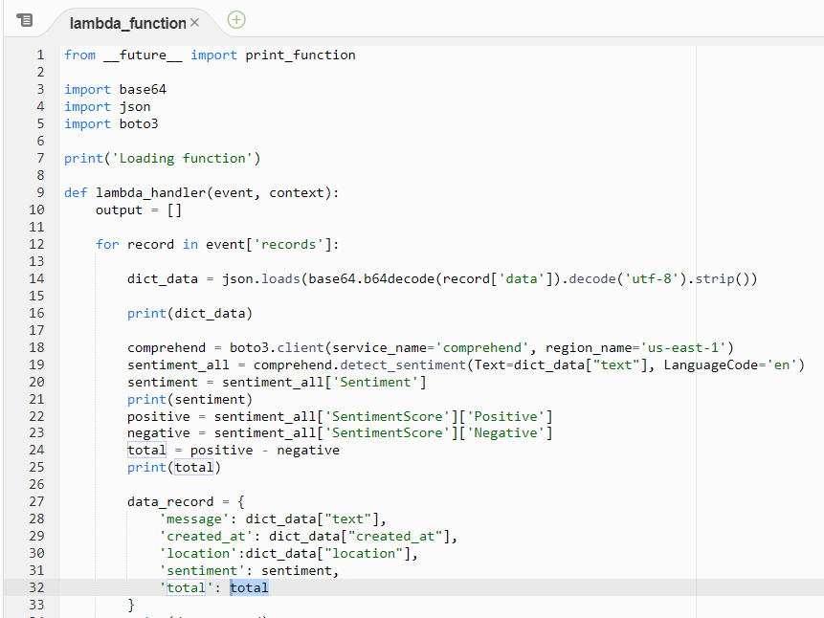
Components
AWS Lambda :
AWS Lambda is a serverless compute service that runs your code in response to events and automatically manages the underlying compute resources.
Notes:
a.AWS Lambda is a serverless compute service that runs your code in response to events and automatically manages the underlying compute resources.
b.The code you run on AWS Lambda is called a “Lambda function.” After you create your Lambda function it is always ready to run as soon as it is triggered, similar to a formula in a spreadsheet.
c.Each function includes your code as well as some associated configuration information, including the function name and resource requirements.
d.Lambda functions are “stateless,” with no affinity to the underlying infrastructure, so that Lambda can rapidly launch as many copies of the function as needed to scale to the rate of incoming events.

Slide 27

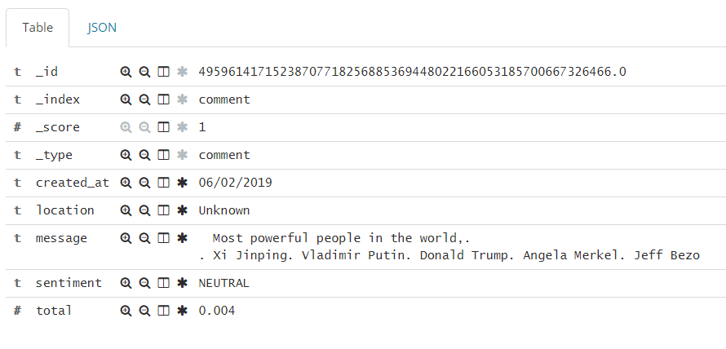
Elastic Search :
Elasticsearch is an open-source, broadly-distributable, readily-scalable, enterprise-grade search engine. Elasticsearch can power extremely fast searches that support your data discovery applications.
Notes:
a.The service offers open-source Elasticsearch APIs, managed Kibana, and integrations with Logstash and other AWS Services, enabling you to securely ingest data from any source and search, analyze, and visualize it in real time.
c.With Amazon Elasticsearch Service, you pay only for what you use. There is no upfront fee or usage requirement.

Slide 28

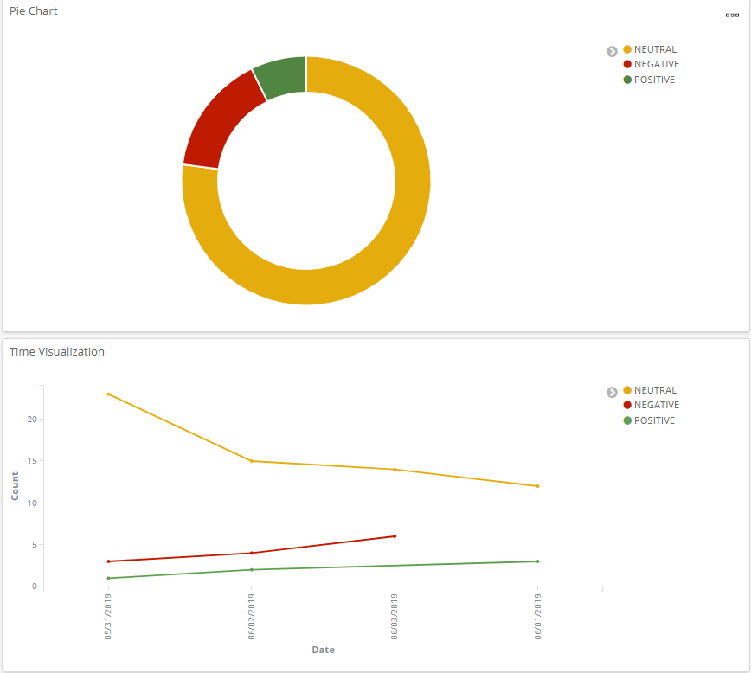
Kibana :
Kibana is an open-source data visualization and exploration tool used for analytics, application monitoring, and operational intelligence use cases.
It provides tight integration with ElasticSearch, which makes Kibana the default choice for visualizing data stored in Elasticsearch.
Notes:
a.Kibana is an open-source data visualization and exploration tool used for analytics, application monitoring use cases.
b.It offers powerful and easy-to-use features such as histograms, line graphs, pie charts, heat maps, and built-in geospatial support.
c.It provides tight integration with Elasticsearch, which makes Kibana the default choice for visualizing data stored in Elasticsearch.
d.You can run Kibana on-premises, on Amazon EC2, or on Amazon Elasticsearch Service. With on-premises or Amazon EC2 deployments, you are responsible for provisioning the infrastructure, installing Kibana software, and managing the cluster. With Amazon Elasticsearch Service, Kibana is deployed automatically with your domain as a fully managed service, automatically taking care of all the heavy-lifting to manage the cluster.

Slide 29




System Architecture
AWS Lambda
AWS Comprehend
EC2 Instance
Kinesis Firehose
Elastic Search
Kibana
Twitter API

Slide 30
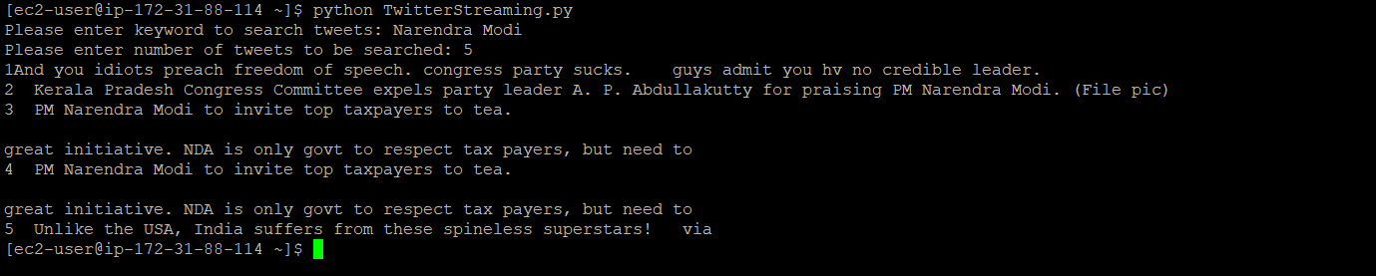
Demo
Running python script on AMI

Slide 31
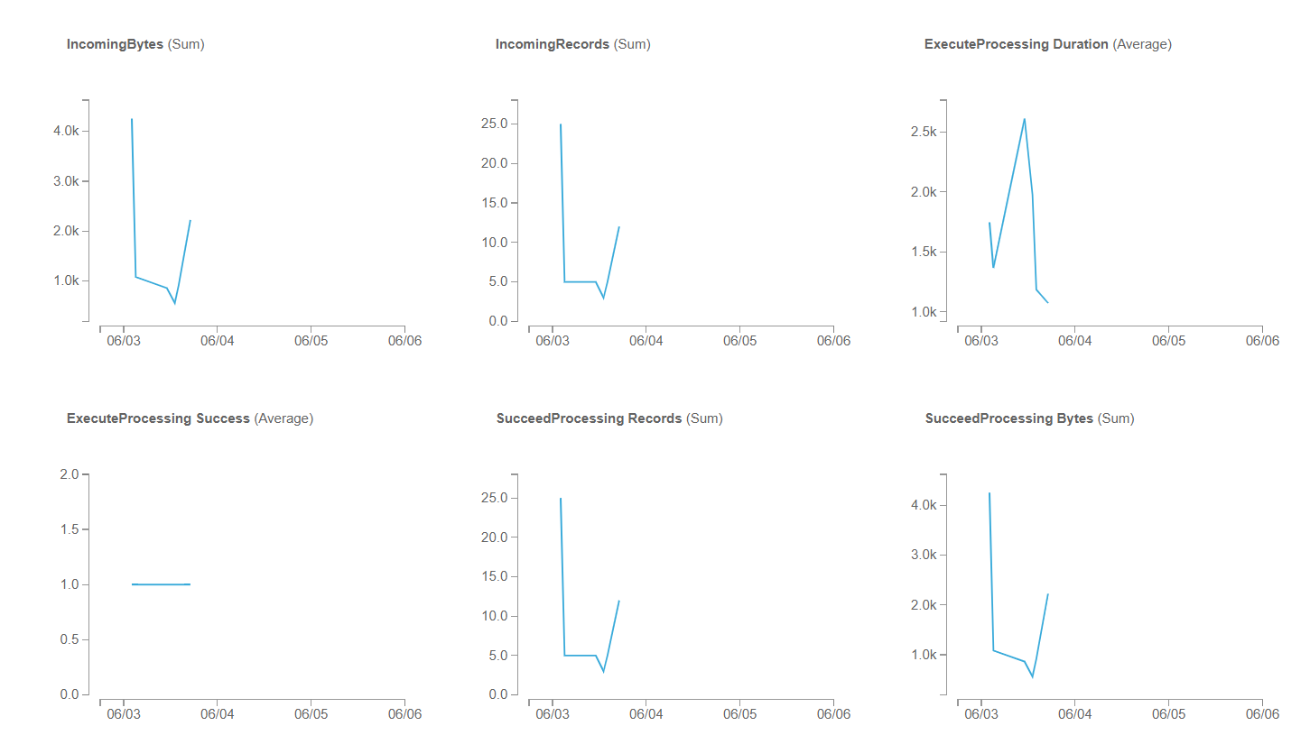
Kinesis Monitor

Slide 32
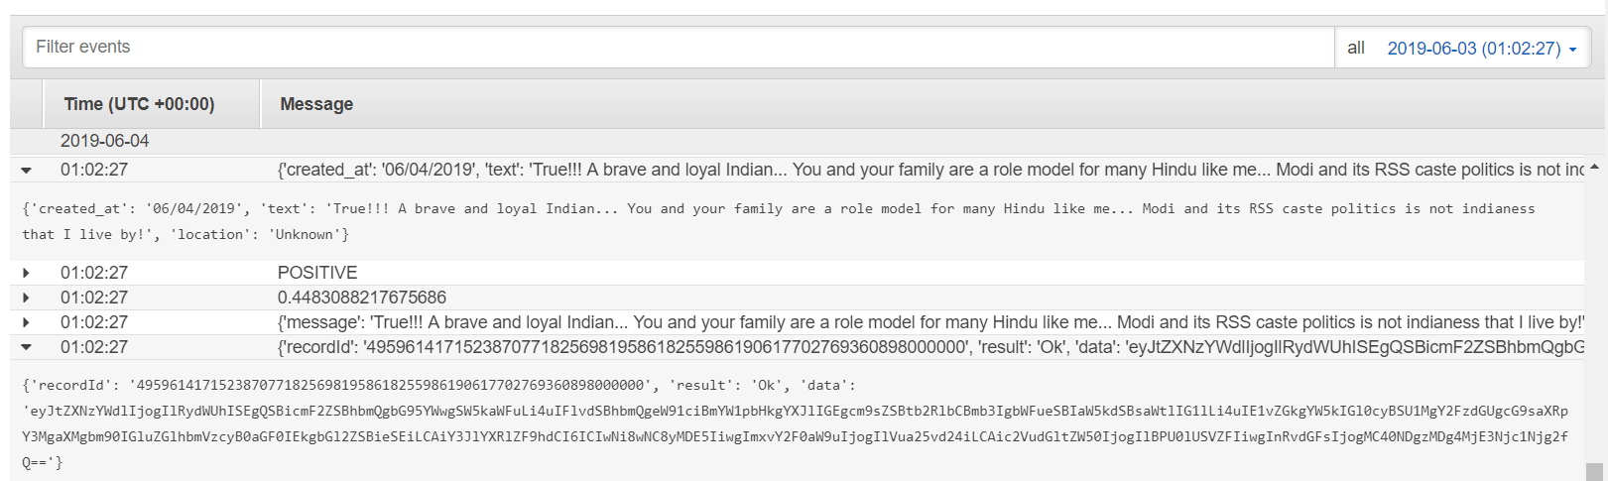
AWS Lambda Logs

Slide 33
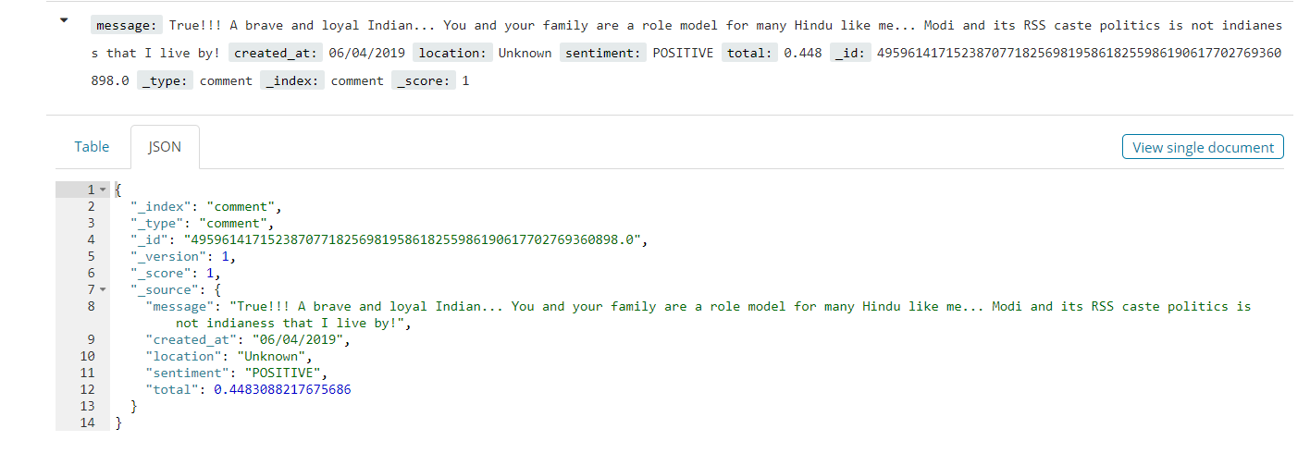
Elasticsearch data snapshot

Slide 34
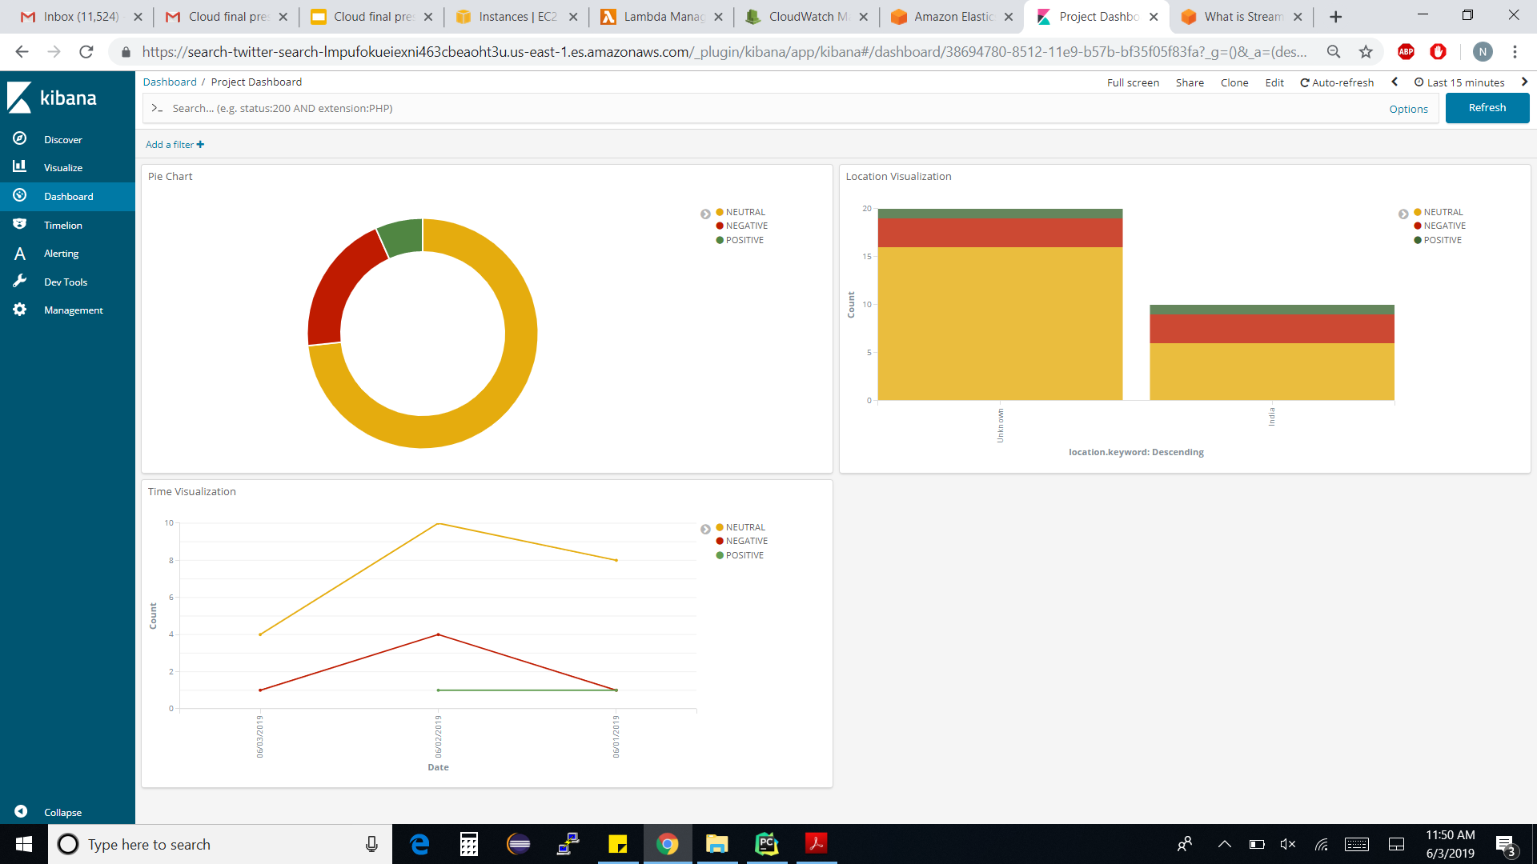
Kibana Visualization

Slide 35
SENTIMENT ANALYSIS ON GOOGLE CLOUD PLATFORM

Slide 36








SYSTEM DESIGN
Pub/Sub Beats
Twitter API
Pub/Sub (Topic)
Cloud Functions
Pub/Sub (Topic)
Python Script on Compute Engine
Logstash
Cloud Natural Language API
Elastic Search
Kibana

Slide 37
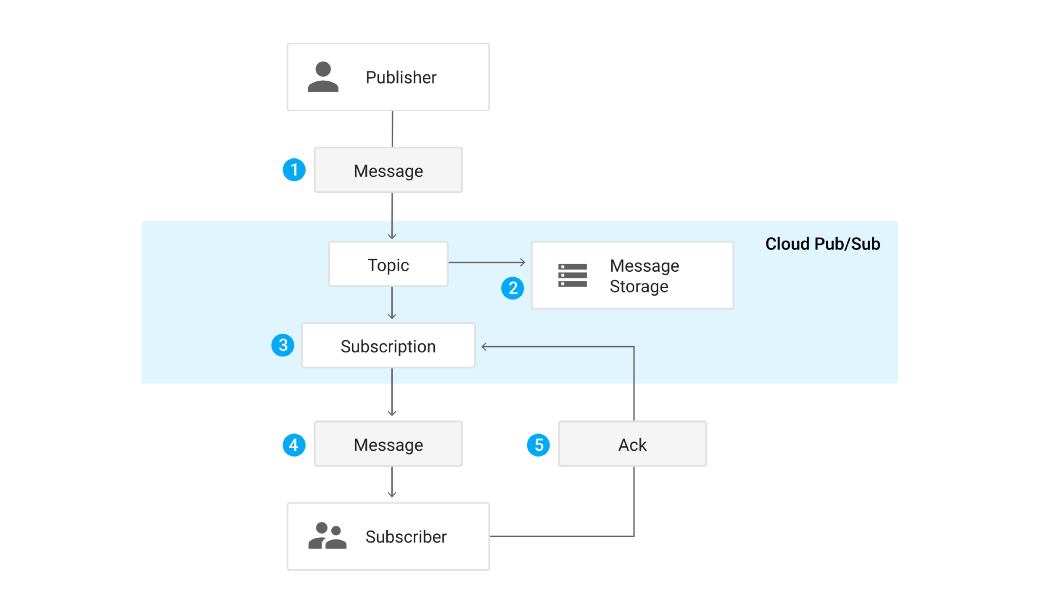
PUB/SUB
Cloud Pub/Sub is a message-oriented middleware to the cloud.
Event ingestion and delivery system that serves as a foundation for modern stream analytics pipelines.
Topic: A named resource to which messages are sent by publishers.
Subscription: A named resource representing the stream of messages from a single topic, to be delivered to the subscribing application.
Message: The combination of data that a publisher sends to a topic and is eventually delivered to subscribers.
Message attribute: A key-value pair that a publisher can define for a message.

Slide 38
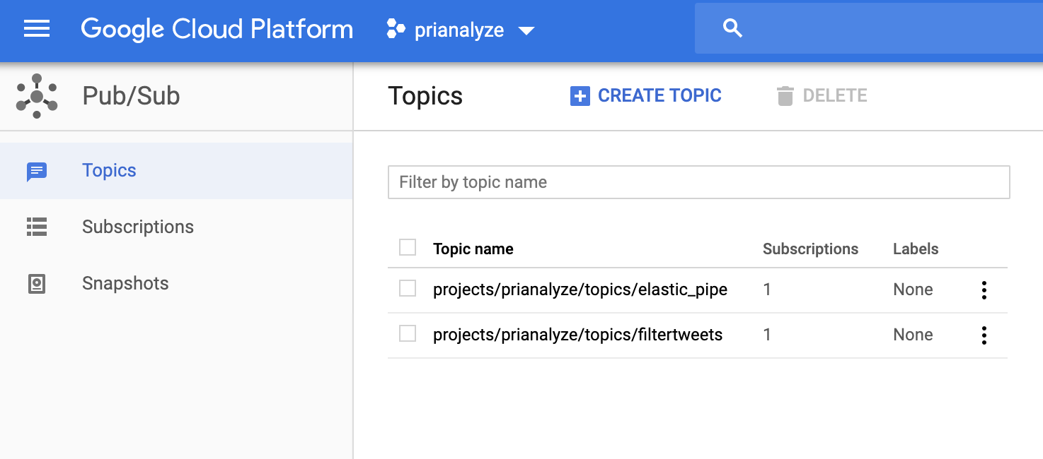
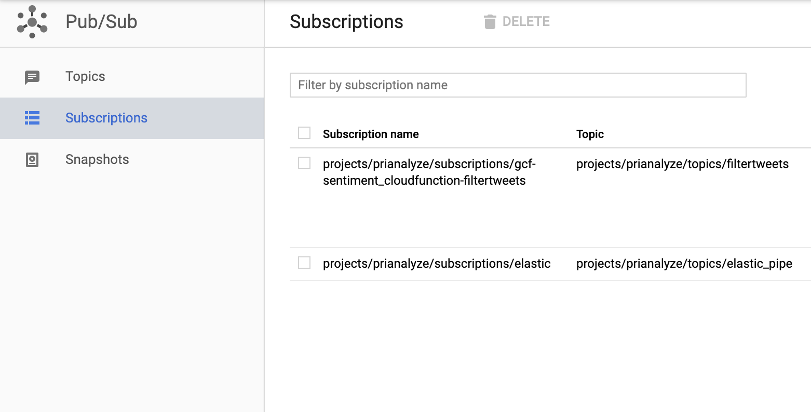
TOPICS/ SUBSCRIPTIONS – Sentiment Analysis

Slide 39
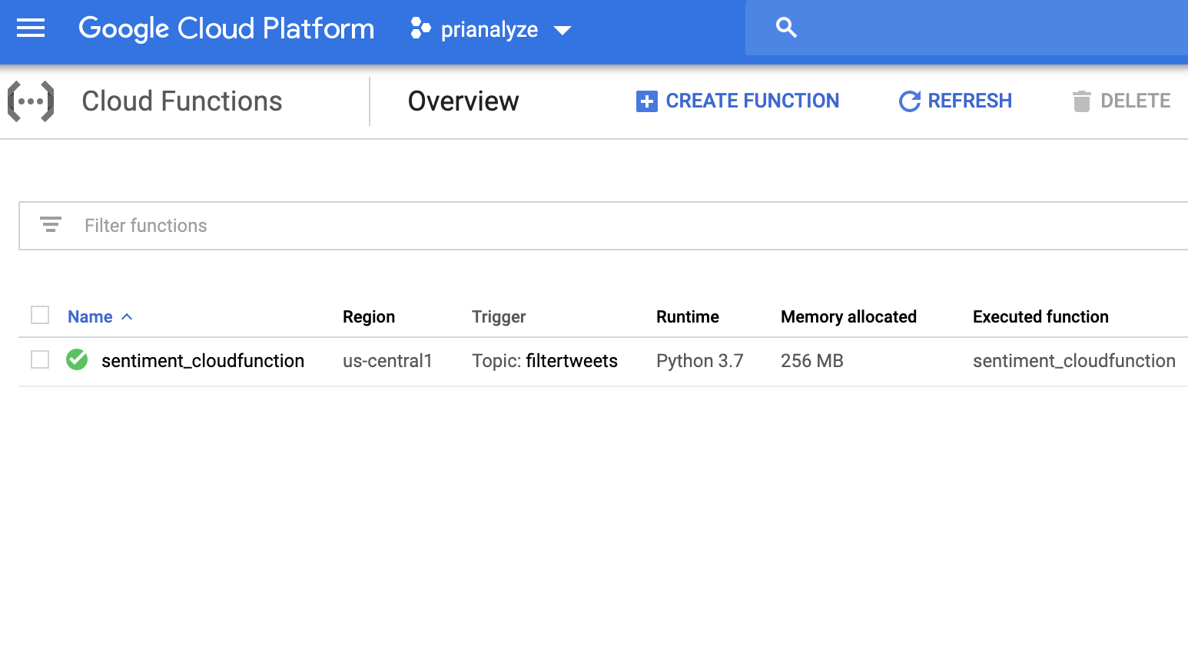
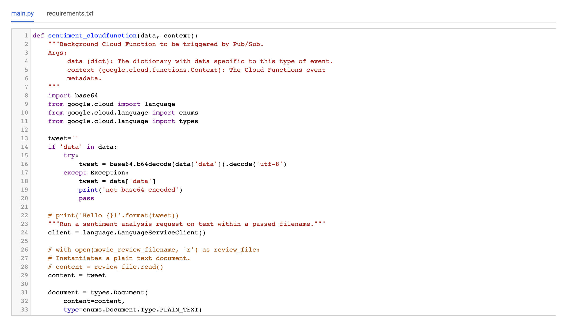
CLOUD FUNCTIONS

Slide 40
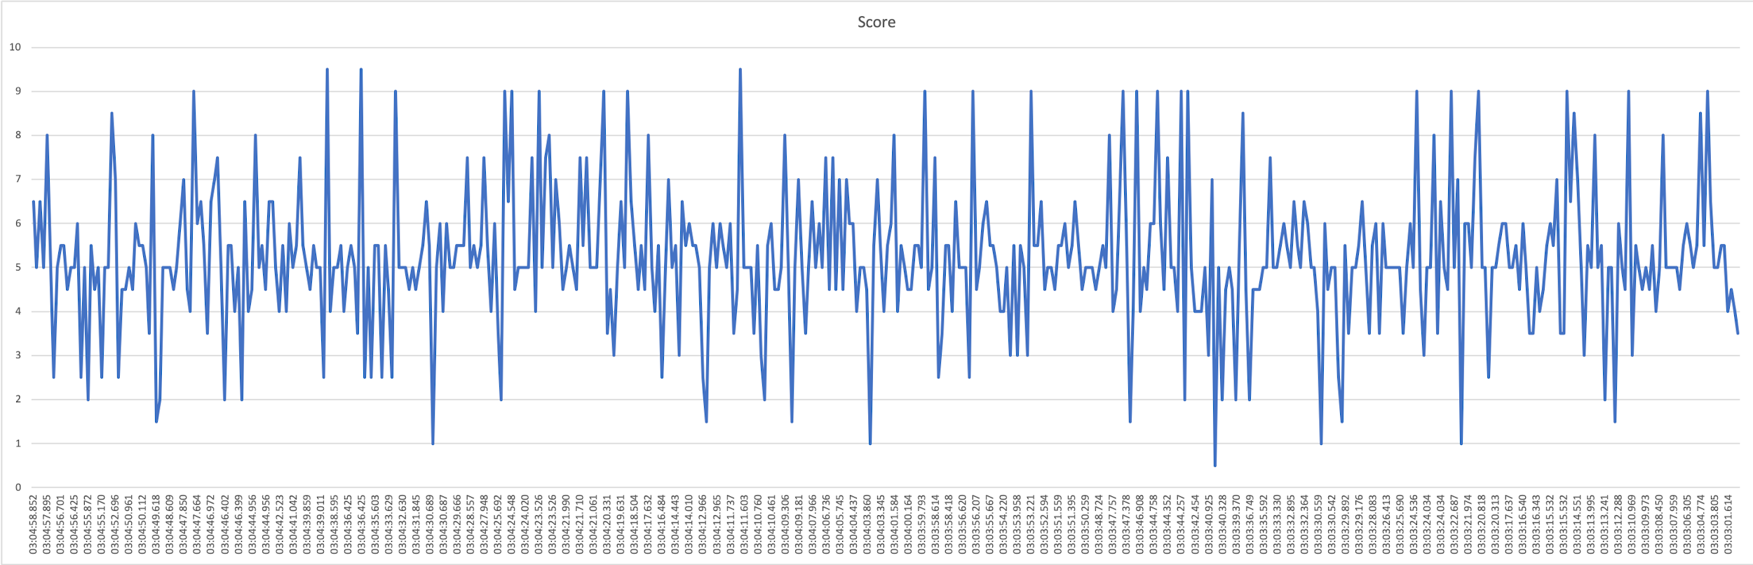
Cloud Natural Language API

Slide 41
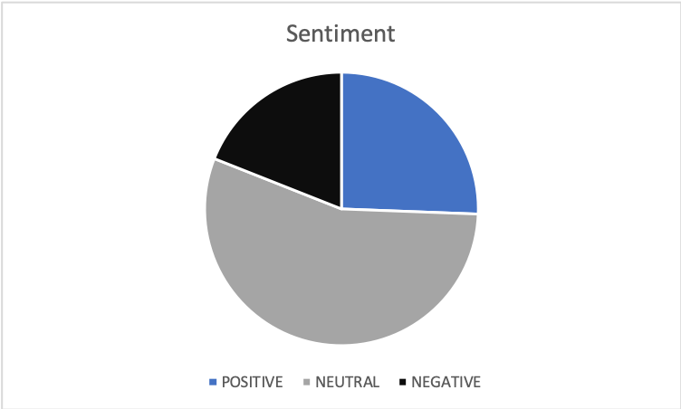
Cloud Natural Language API
0-3 – Negative 19%
4-6 – Neutral 55%
6- 10 – Positive 26%

Slide 42
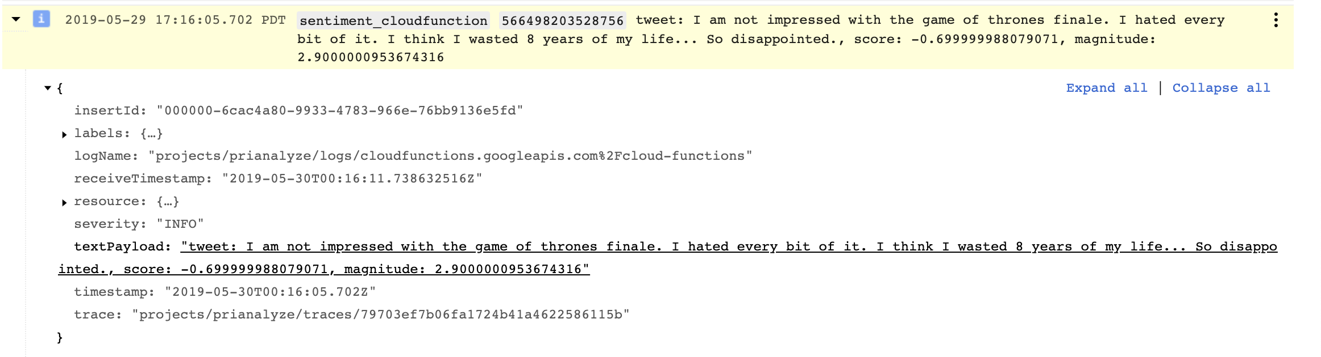
SCORE FROM NL API
Range defined between -1 to +1

Slide 43
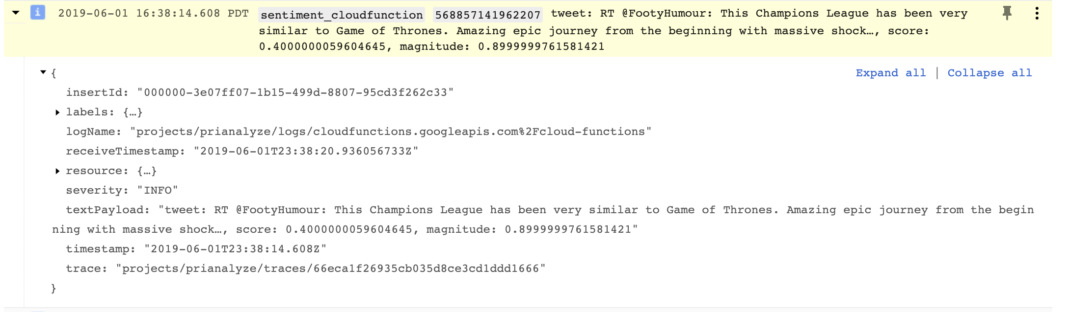
SCORE FROM NL API

Slide 44
E-L-K
Logstash: The server component of Logstash that processes incoming logs.
Elasticsearch: Stores all of the logs.
Kibana: Web interface for searching and visualizing logs.
-- Key value default parsing.

Slide 45
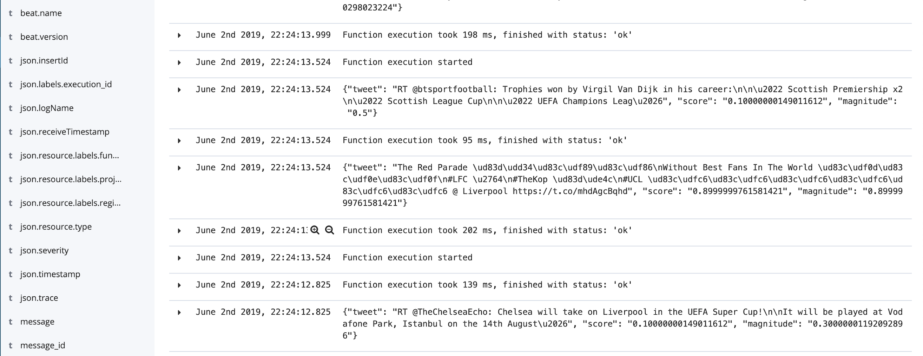
E-L-K

Slide 46



CHALLENGES WITH GCP
Integration with Elasticsearch.
No default visualization app within GCP
Not many options to store the logs in the sink.
Higher accuracy – more granular compared to AWS which gives 3 levels.

Slide 47



CONCLUSION
Speed- AWS
Accuracy- Google Cloud Platform, Higher granularity,
Configurable with 3rd party apps- AWS
Configurable with granularity - Google Cloud Platform
Setup Time: GCP sdk easier to set up locally
Reliability and Services - Both
Pricing-:
More requests- AWS
More data - GCP

Slide 48
References
https://cloud.google.com/natural-language/docs/basics
https://www.deducive.com/blog/2018/6/02/using-r-for-sentiment-analysis-with-aws-comprehend-google-cloud-natural-language-ibm-watson
https://towardsdatascience.com/step-by-step-tutorial-pyspark-sentiment-analysis-on-google-dataproc-fef9bef46468
https://cloud.google.com/free/docs/map-aws-google-cloud-platform
https://activewizards.com/blog/comparison-of-the-most-useful-text-processing-apis/
https://www.researchgate.net/publication/328905368_Sentiment_Analysis_Tool_on_Cloud_Software_as_a_Service_Model

